Slide 1

House prices data using the power bi service
Andrew Jensen

Slide 2
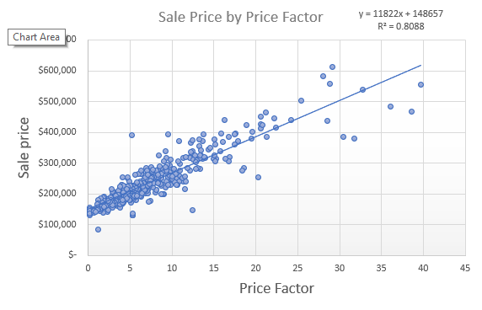
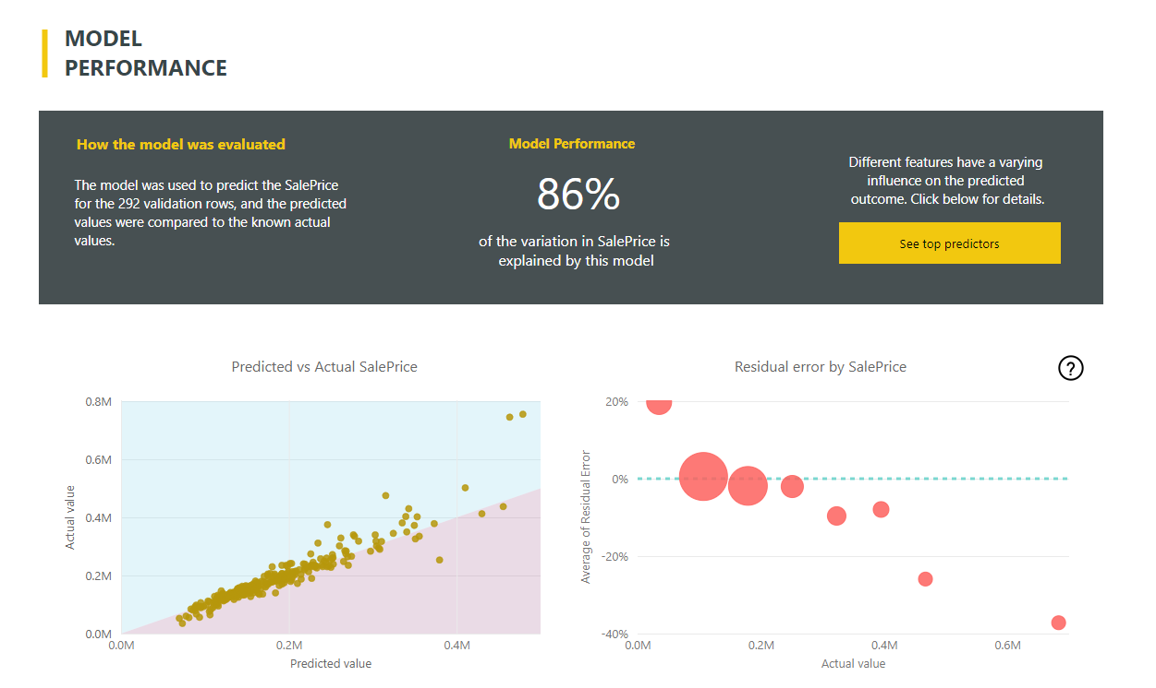
The power of machine learning
45 Minutes
10 Minutes

Slide 3
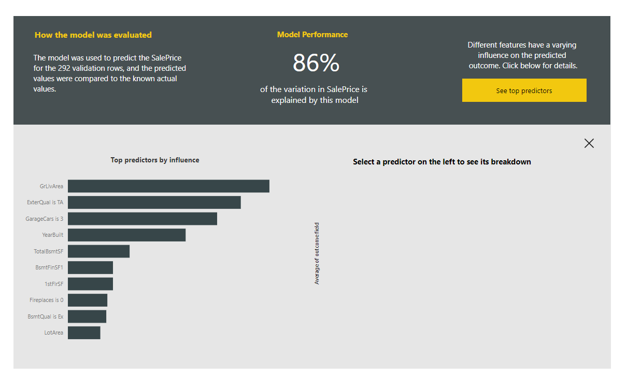
Key indicators

Slide 4
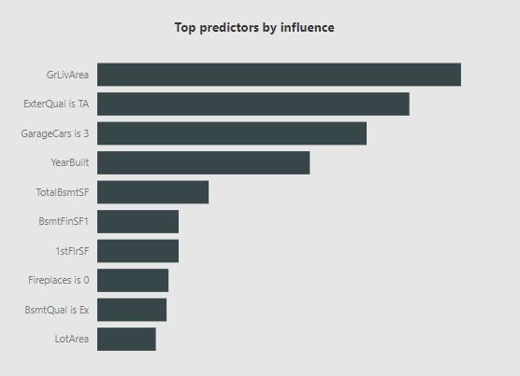
Key indicators

Slide 5
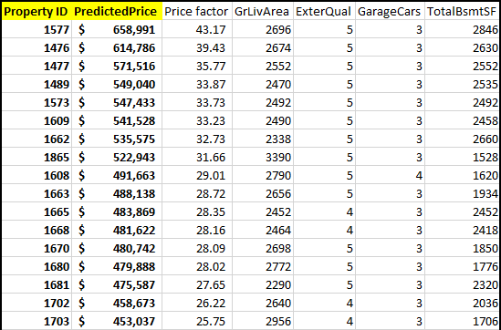
Price predictions

